Slide 1
GlowCosmetic Online Product
Developed by :
Angel Raiyani
Developed At :
Decent Infoways Pvt. Ltd.
Guide :
Prof. Dhaval Lal

Slide 2

About Company
Decent Infoway, founded in 2013, is an IT services company based in Rajkot, Gujarat, India. We specialize in custom software development, web and mobile applications, digital solutions and consultancy. Our expertise spans modern technologies including the MERN stack, Flutter, ASP.NET, and cloud platforms. Committed to quality, innovation and customer satisfaction, Decent Infoway empowers businesses to succeed in the digital era through reliable, scalable, and cost-effective technology solutions.

Slide 3
Objective Of Product
Build a fast, responsive e-commerce site for cosmetics with smooth product browsing and checkout.
Support category-based browsing, filters, product variants (size, shade), and search with pagination.
Provide secure login, JWT authentication, and role-based access for Admin, Customer, and Staff.
Admin dashboard to manage products, categories, offers, users, orders, and site content (About, Contact).
Product ratings & reviews, and basic SEO-friendly pages for better discoverability.

Slide 4
Project Profile
Project Name: GlowCosmetic – Online Cosmetics Store
Frontend: React.js (JavaScript, JSX, Bootstrap,css )
Backend: Node.js with Express.js
Database: MongoDB with Mongoose
Other Tools: Git/GitHub, Postman (API Testing), Razorpay (Payment Gateway), JWT Authentication
Team Members:
Angel Raiyani (24SOECA21089)
Project Guide: Chirag Hirani , Technical Head
At: Decent Infoways Pvt. Ltd.

Slide 5
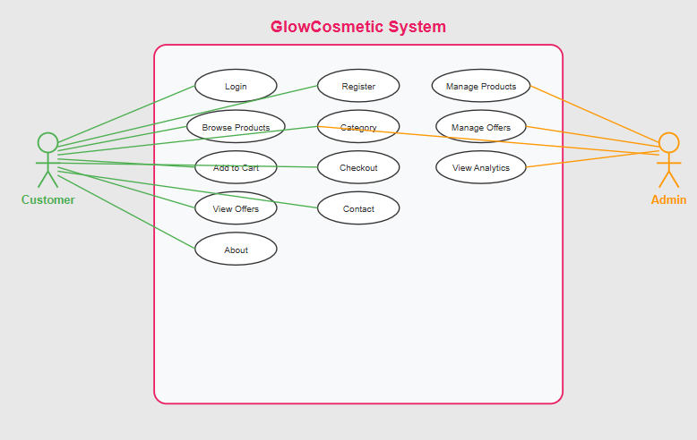
Use Case Diagram

Slide 6
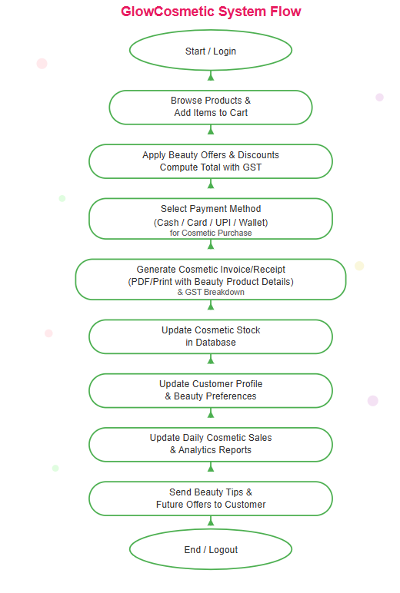
System Design

Slide 7
Data Dictionary
User :
Field Name | Data Type | Size/Format | Description | Constraints / Default Value
fullname | String | Variable (max ~255 chars typical) | Full name of the user | Required
email | String | Valid email format | Unique email address of the user | Required, Unique
mobile | String | 10–15 digits | Mobile phone number of the user | Required
password | String | Encrypted/hashed string | User login password | Required
gender | String | "Male", "Female", "Other" | Gender of the user | Required
pincode | String | 6–10 digits | Area/ZIP code of user’s location | Required
address | String | Variable | Residential address of the user | Required
profilePic | String (URL/path) | Variable | Path or URL of the profile picture | Default: null
role | String | e.g., "user", "admin" | Role assigned to the user | Default: "user"
status | String | "Active"/"Inactive" | Account status of the user | Default: "Inactive"
token | String | JWT or session token | Authentication/verification token | Optional, Default: null
createdAt | Date | ISO Date format | Record creation timestamp | Default: Date.now

Slide 8
Data Dictionary
Product :
Field Name | Data Type | Size/Format | Description | Constraints / Default Value
name | String | Variable (trimmed) | Name of the product | Required
description | String | Variable | Detailed description of the product | Default: ""
price | Number | Decimal | Selling price of the product | Required, min: 0
stock | Number | Integer | Available stock quantity | Required, min: 0, Default: 0
status | String | "active" / "inactive" | Current availability status of the product | Default: "active"
ml | String | Variable (e.g., "100ml") | Net quantity/volume of the cosmetic product | Default: ""
discount | Number | 0–100 | Discount percentage on the product | min: 0, max: 100, Default: 0
category | ObjectId (Reference) | Ref → Category Collection | Category under which the product belongs | Required
image | String (URL/path) | Variable | Path or URL of the product image | Default: ""
createdAt | Date | ISO Date format | Record creation timestamp | Default: Date.now
updatedAt | Date | ISO Date format | Last modified timestamp | Auto-updated before save

Slide 9
Data Dictionary
Cart :
Field Name | Data Type | Size/Format | Description | Constraints / Default Value
userId | ObjectId (Reference) | Ref → User Collection | The user who owns the cart | Required
productId | ObjectId (Reference) | Ref → Product Collection | The product added to the cart | Required
quantity | Number | Integer | Number of units of the product added to the cart | Default: 1
createdAt | Date | ISO Date format | Timestamp of when the cart entry was created | Default: Date.now

Slide 10
Data Dictionary
Wish List :
Field Name | Data Type | Size/Format | Description | Constraints / Default Value
userId | ObjectId (Reference) | Ref → User Collection | The user who added the product to the wishlist | Required
productId | ObjectId (Reference) | Ref → Product Collection | The product that is saved in the wishlist | Required
createdAt | Date | ISO Date format | Timestamp of when the product was added to the wishlist | Default: Date.now

Slide 11
Data Dictionary
Contact Us :
Field Name | Data Type | Size / Format | Description | Constraints / Default Value
name | String | Text | Name of the person submitting the contact form | Required
email | String | Email format | Email of the person submitting the contact form | Required
phone | String | Text / Number | Contact number of the person | Required
message | String | Text | Message submitted by the user | Required
reply | String | Text | Reply from admin to the user's message | Default: empty string ('')
createdAt | Date | ISO Date | Timestamp when the message was created | Default: Date.now
status | String | Text | Status of the message (e.g., New, Replied) | Default: 'New'
seen | Boolean | True/False | Whether the message has been viewed by admin | Default: false
seenAt | Date | ISO Date | Timestamp when the message was marked as seen | Optional

Slide 12
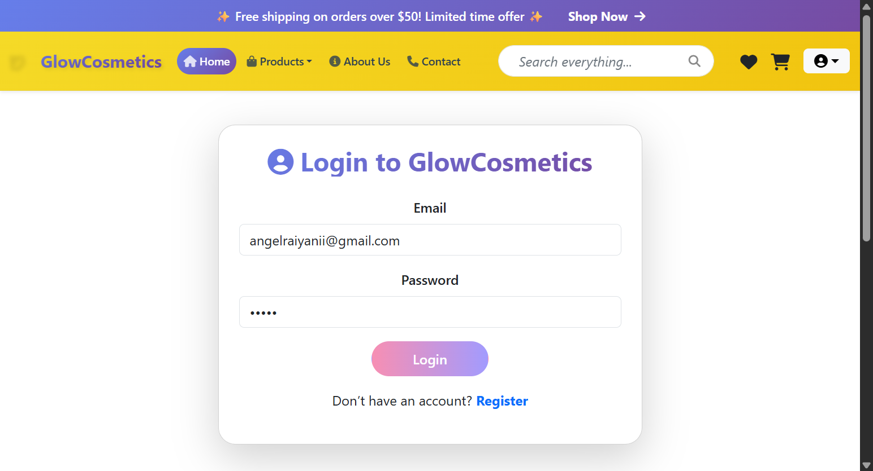
Screen Shorts
Login Page

Slide 13
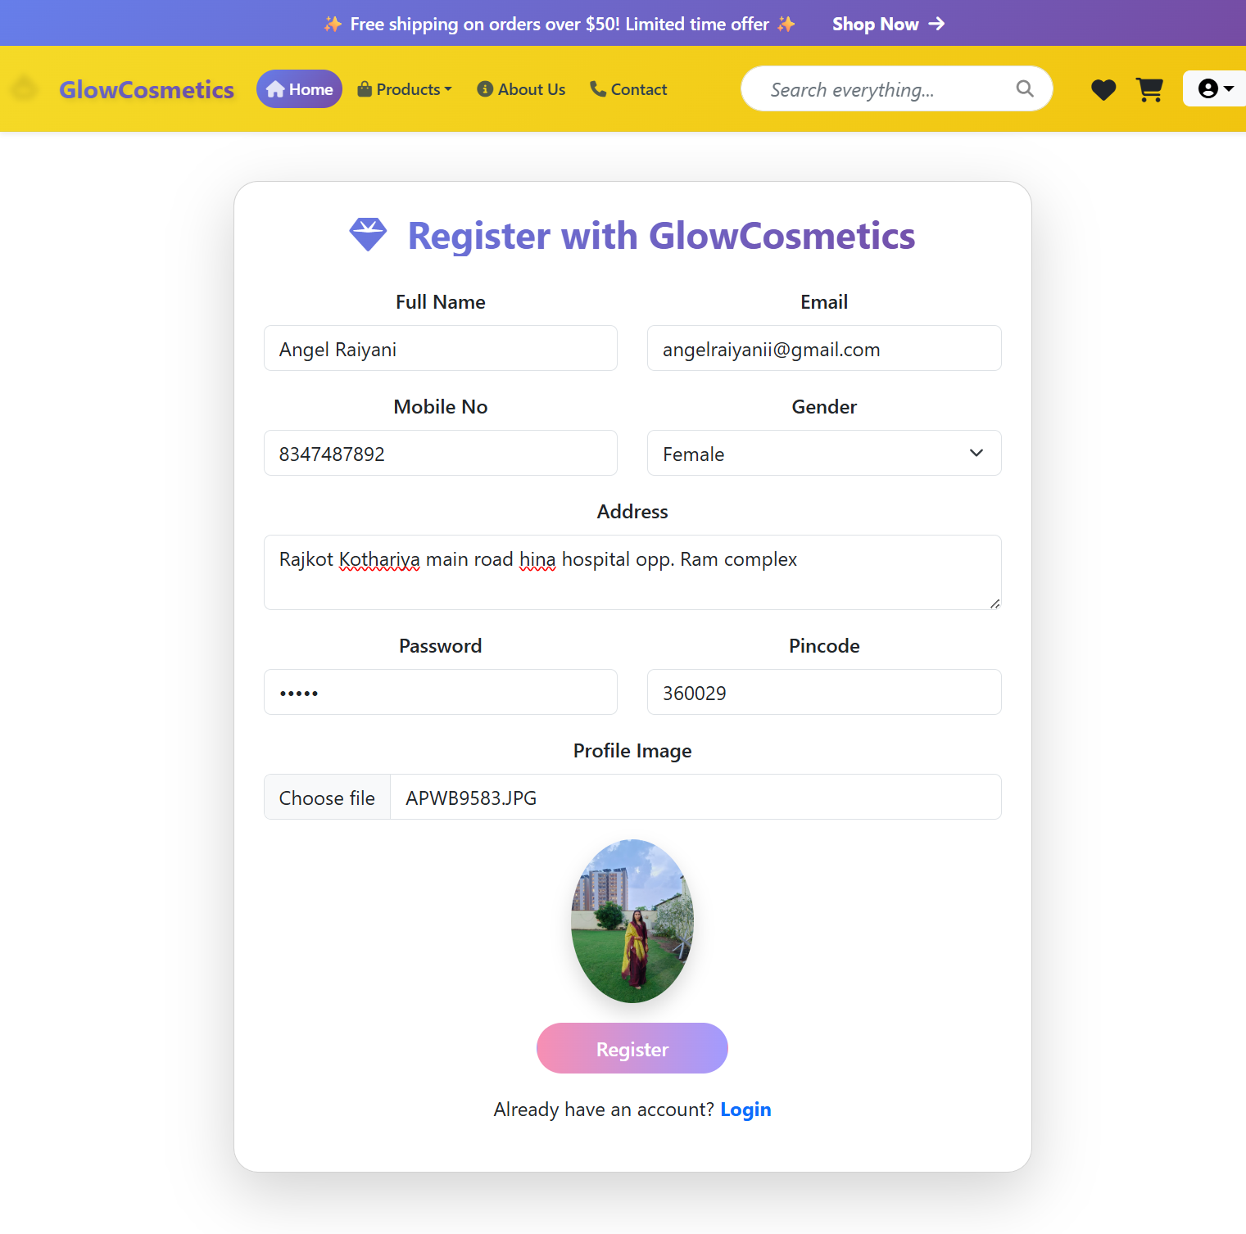
Screen Shorts
Registor Page

Slide 14
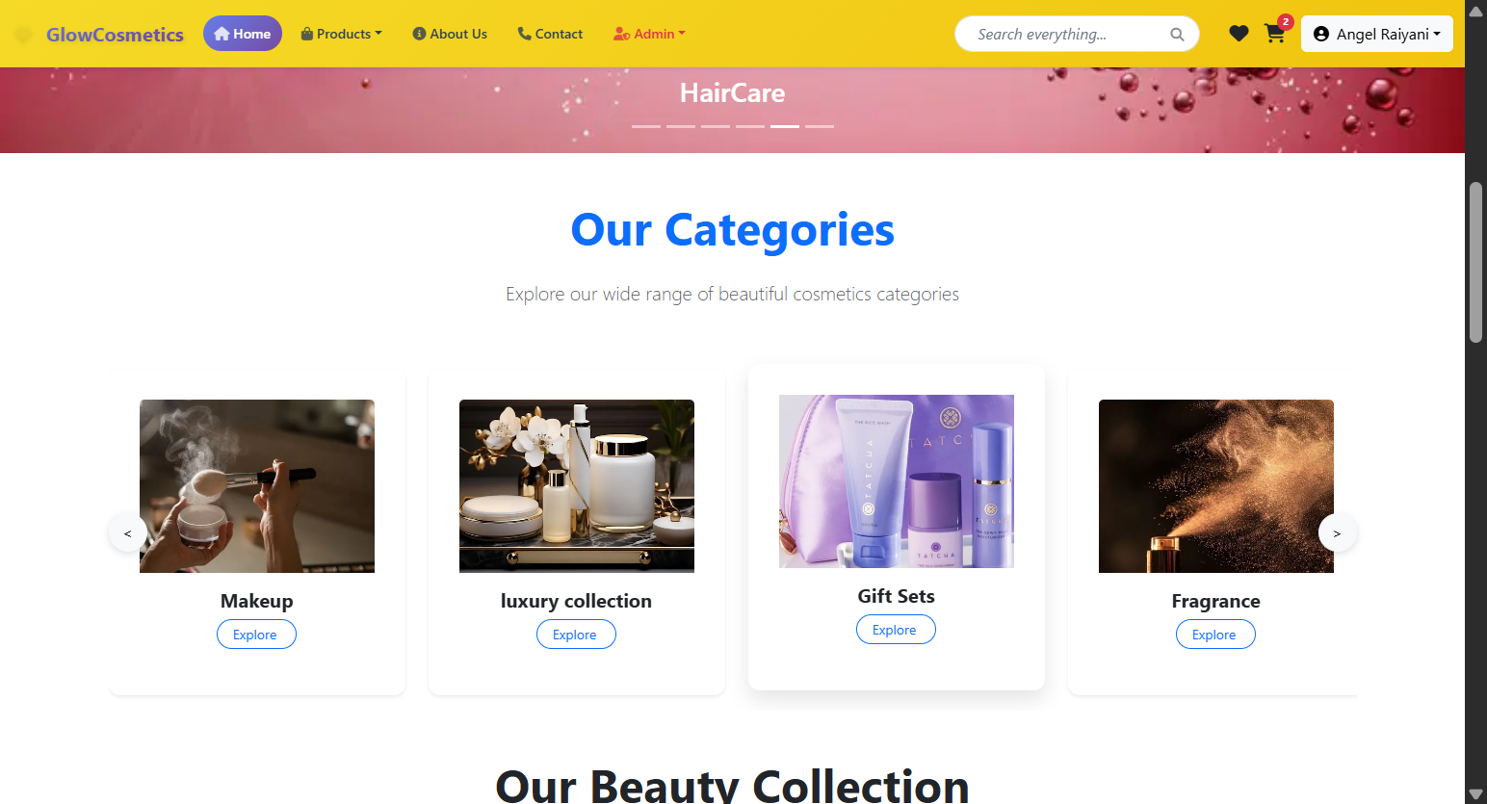
Screen Shorts
Dashbord

Slide 15
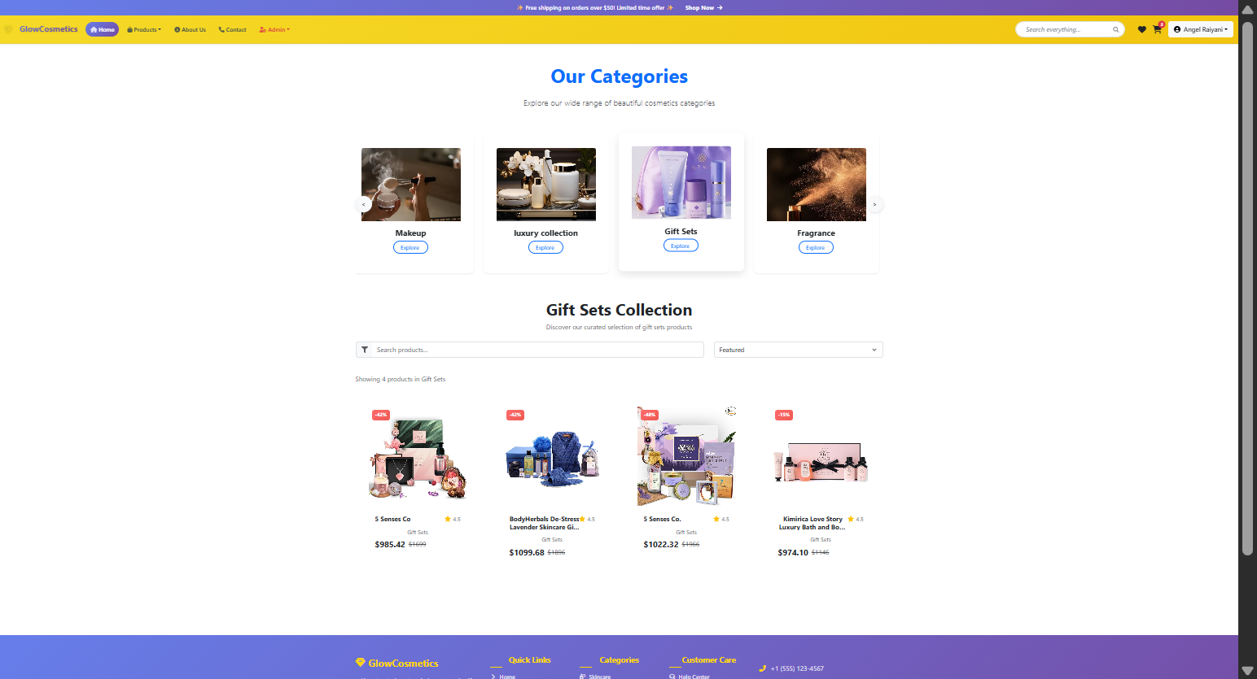
Screen Shorts
Category Page

Slide 16
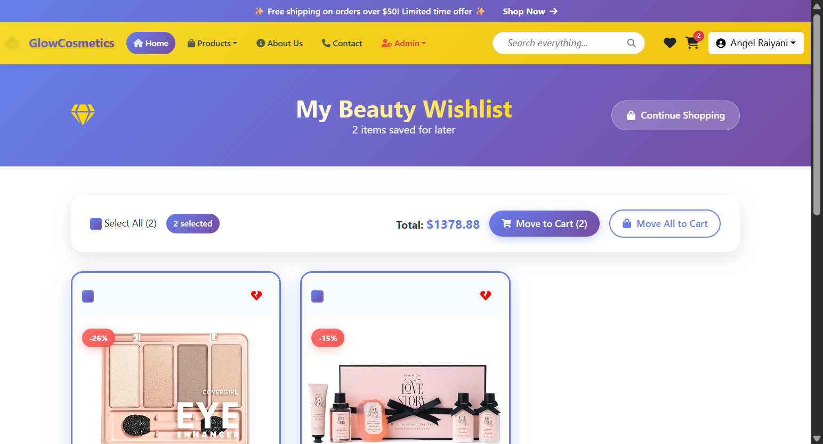
Screen Shorts
Wish List Page

Slide 17
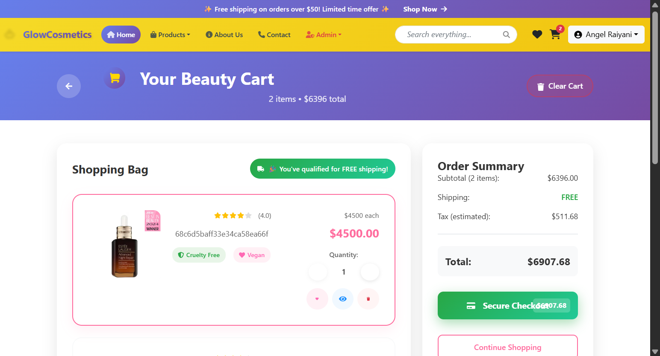
Screen Shorts
Cart List Page

Slide 18
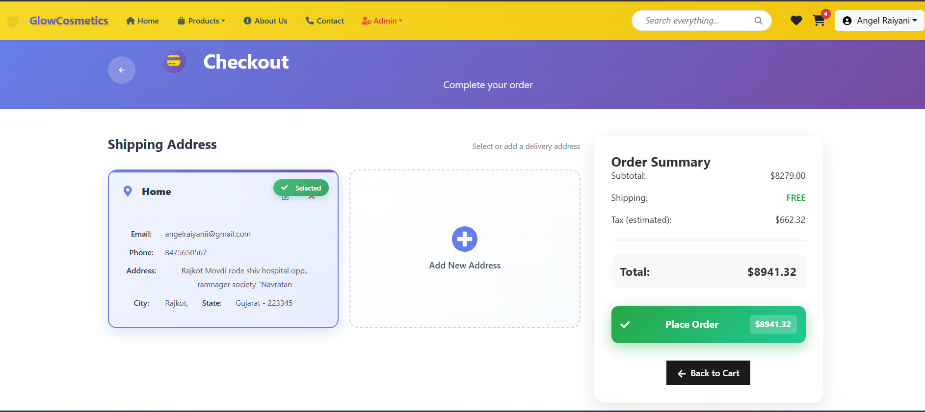
Screen Shorts
Check Out Page

Slide 19
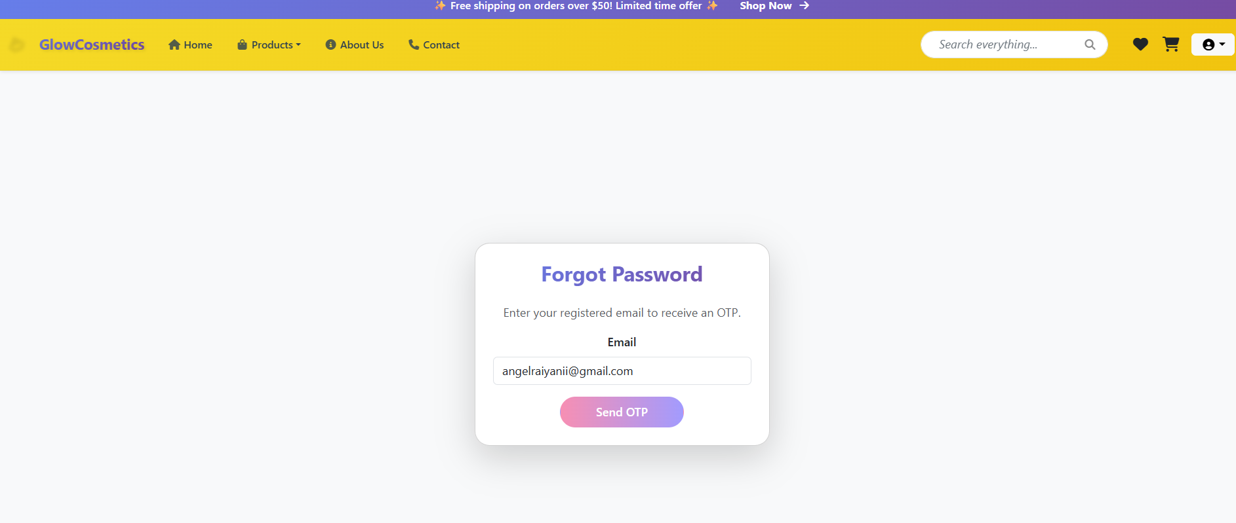
Screen Shorts
Forgot Password Page

Slide 20
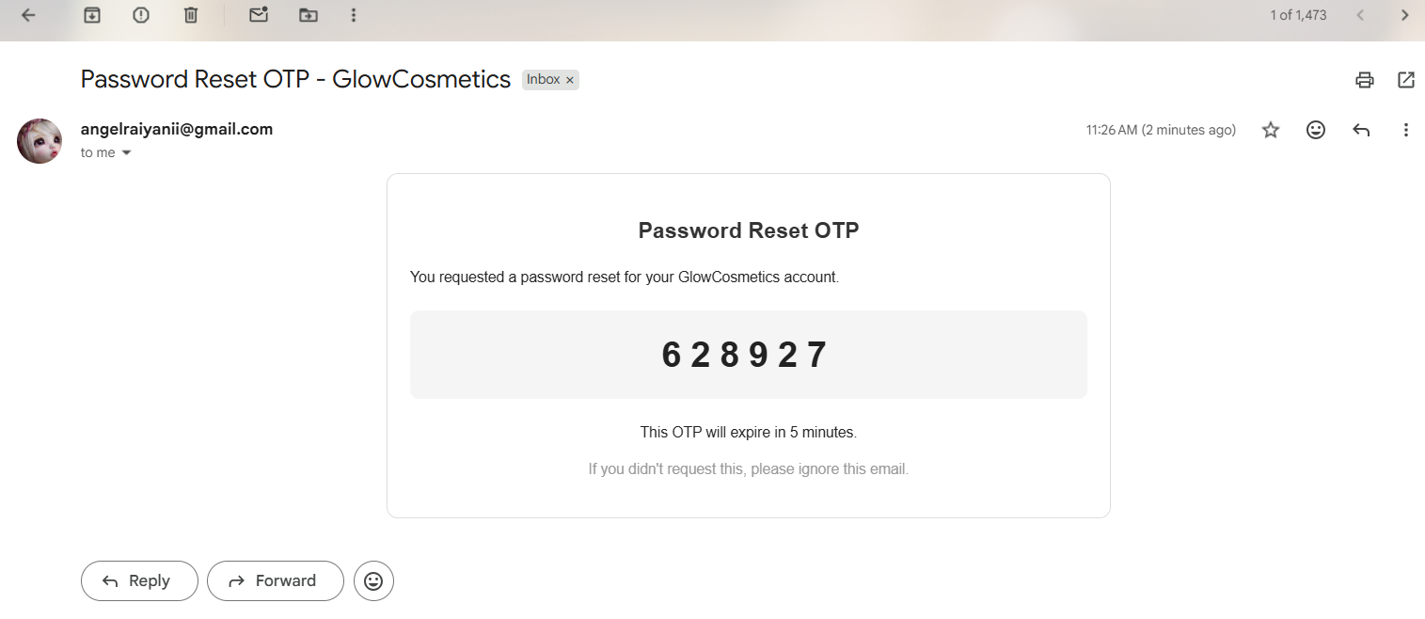
Screen Shorts
Mail receive (User)

Slide 21
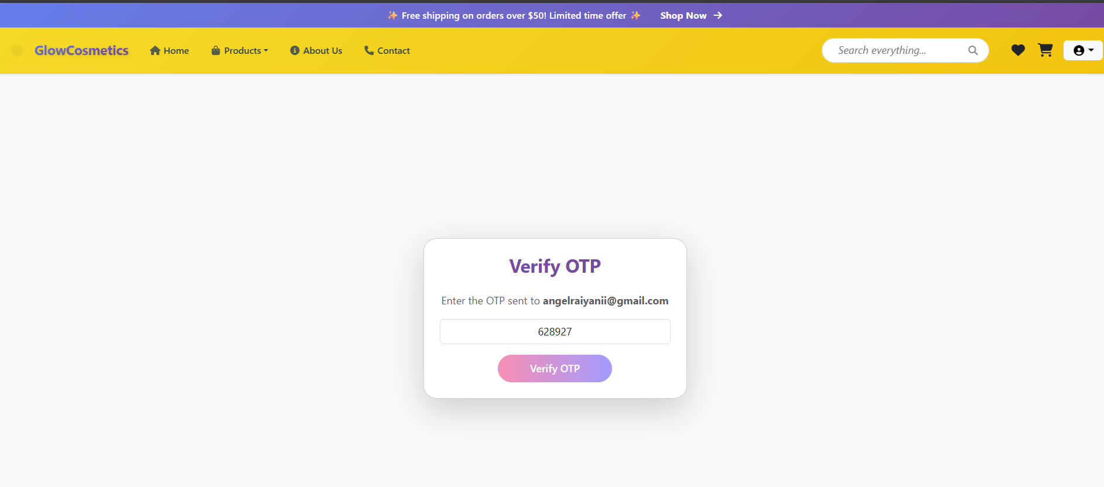
Screen Shorts
OTP Verification Page

Slide 22
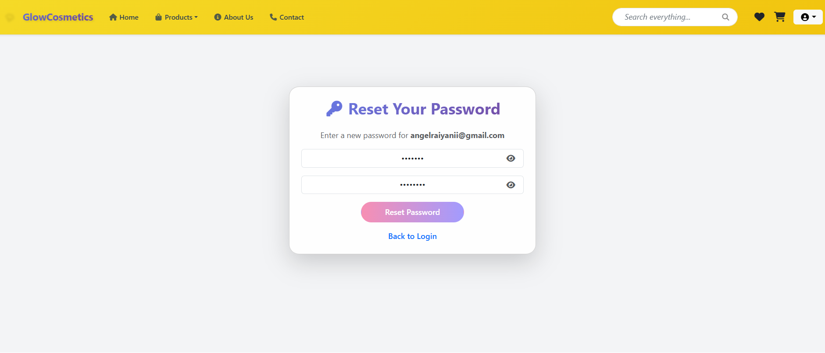
Screen Shorts
Reset Password Page

Slide 23
LIMITATIONS & FUTURE ENHANCEMENTS
Future Enhancements (GlowCosmetic Website)
Offline-first support with auto-sync – Allow users to browse products and add to cart even without internet; sync automatically when online.
Multi-branch/store management – Extend the platform to handle multiple stores, inventory, and sales from different locations.
Advanced analytics and reports – Introduce dashboards, detailed sales insights, and customer behavior analysis.
Hardware integration – Connect with barcode scanners, receipt printers, and other billing devices for faster checkout.
Dedicated mobile app – Launch native apps for Android and iOS to improve user experience and accessibility.
Limitations (GlowCosmetic Website)
Limited offline functionality – The website requires an internet connection to fetch product data, user info, and process orders.
Single-store focus – Currently supports only one store/branch setup; multi-branch management is not available.
Basic analytics – Offers only simple sales and user statistics; no advanced reporting or insights.
Limited device integration – No integration with billing hardware (like barcode scanners or POS printers).
No dedicated mobile app – Users can access the website via mobile browsers, but there is no standalone mobile app.

Slide 24
Reference
Google
ChatGPT
Myntra
Flipkart

Slide 25
Thank you

